Slide 1
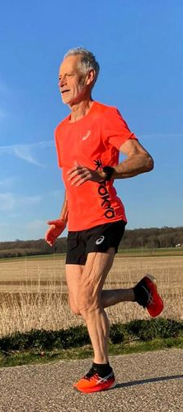

Muscles and Ageing
Dr Ben Hunter
b.hunter@londonmet.ac.uk
Notes:
world record for the 70+ age category at Belgium’s Maasmarathon of Visé
Schoonbroodt, from Maastricht in the Netherlands, crossed the finish line in a blisteringly quick 2:54:19.

Slide 2
Session Content
Describe changes of muscle mass and strength with age
Explain the role of exercise in minimising deterioration
Describe prevalence of falls, fall risk factors, and exercise for prevention
Notes:
1 horsepower lifts 550 lb by 1 foot in 1 second

Slide 3
Ageing and Physical Condition
Men: VO2max tends to drop 5 ml/kg/min each decade starting at age 20 (drop fro 45 ml/kg/min)
Women: VO2max tends to drop 5 ml/kg/min each decade starting at age 35 (drop from 38 ml/kg/min)
Once VO2max drops to 18 ml/kg/min for men and 15 ml/kg/min for women a person loses functional independence
Aerobic activity (e.g., brisk walking) can slow decline significantly
Shephard, R. J. (2008). Maximal oxygen intake and independence in old age. British Journal of Sports Medicine, pp 1-19
Notes:
1 horsepower lifts 550 lb by 1 foot in 1 second

Slide 4
Ageing and Muscle Loss
As a normal part of the aging process, individuals experience a loss of skeletal muscle.
Muscle and strength loss has been documented in individuals over the age of 40 (Melov et al., 2007)
This loss of muscle tissue, with an associated loss of strength and mass, is referred to as sarcopenia.
Sarcopenia can begin as early as the fourth decade of life. However, by the seventh and eighth decades of life, a decrease in the maximal contractile strength on the order of 20-40% for both men and women is observed.
Notes:
1 horsepower lifts 550 lb by 1 foot in 1 second

Slide 5
Age-related Changes to Muscle Structure
Reduced muscle mass (replaced by increased fat mass)
Reduced muscle strength
Changes in muscle fibre size
Decreased motor unit number and size
Notes:
Increased intramuscular adipose tissue with older inpatients who were unable to walk independently as compared to older inpatients who were able to walk freely
The decline in muscle cross-sectional area is most likely due to decreases in total fiber number, especially type II fast-twitch glycolytic fibers
Types IIA and IIB muscle fibers decrease with age in the area percentage, fiber number percentage, and mean fiber area, whereas Type I fibers increase in area and number but not in size.
In the aged motor unit there are decreased in the number of functional motor units associated with enlargement of the cross sectional area of the remaining units. This motor unit remodelling is achieved by selective denervation of muscle fibers ->
reinverated with a different motor neuron most likely that of a slow-twitch neuron

Slide 6
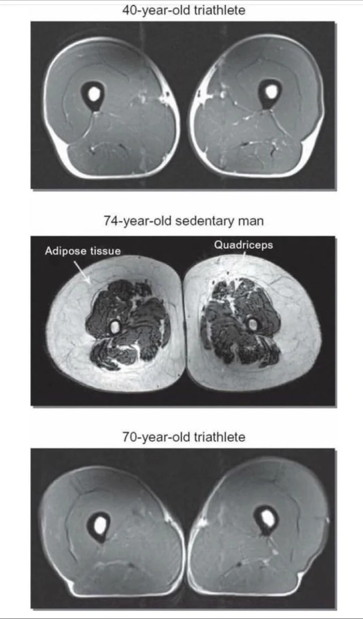
Notes:
1 horsepower lifts 550 lb by 1 foot in 1 second

Slide 7
Sarcopenia
Involuntary loss of skeletal muscle mass, strength, and function.
Factors which contribute to sarcopenia include:
  Oxidative stress
  Cell death
  Inflammation
  Hormonal dysregulation
  Inactivity
  Alterations in protein turnover
  Mitochondrial dysfunction
Notes:
Decreased levels of sex hormones (testosterone and DHEA)
Decreased levels of growth hormone and insulin-like growth factor 1 (IGF-1)
Increased cytokine production (i.e., IL-1, IL-6, TNF-α, etc.)
Neuromuscular
Malnutrition (especially protein deficiency)
changes

Slide 8
Consequences of Sarcopenia
Reduced function
  Loss of approximately 40% of lean body mass is fatal
Reduction of muscle size
Reduction in satellite cells
  Plays a role in muscle growth, repair, and regeneration, mitochondrial numbers, and elasticity.
Sarcopenia is seen in increasing numbers with advancing age but is not universal.
Sarcopenia varies in degree of physical activity, gender, and race.
Contributes (along with reduction in balance) to reduced gait speed.
The combination of osteoporosis and sarcopenia results in the frailty which frequently occurs in the elderly population.
Notes:
Satellite cells: a stem cell that lies adjacent to a skeletal muscle fibre and plays a role in muscle growth, repair, and regeneration[7]), mitochondrial numbers, and elasticity.

Slide 9
Consequences of Sarcopenia
Increased insulin resistance
Decreased GH
Reduction in sex hormones
Vitamin D deficiency
Increased parathyroid hormone
Notes:
Diabetes
Metabolic syndrome
Chronic Obstructive Airways Disease (COPD)
Congestive Cardiac Failure
Osteoarthritis
Parkinsons
Cancer
Stroke
Chronic Kidney Disease

Slide 10
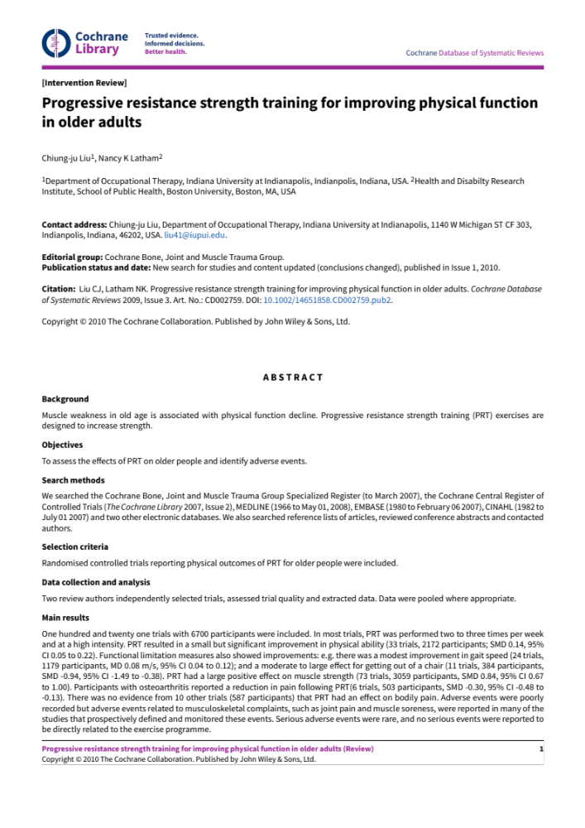
Minimising the Deterioration
"This review provides evidence that PRT (Progressive resistance strength training) is an effective intervention for improving physical functioning in older people, including improving strength and the performance of some simple and complex activities. However, some caution is needed with transferring these exercises for use with clinical populations because adverse events are not adequately reported."
Notes:
One hundred and twenty one trials with 6700 participants were included

Slide 11
Minimising the Deterioration
Resistance training (2-3 times per week)
Moderate aerobic activities (>150 min per week)
Adequate protein and energy intake
  Patients with sarcopenia recommended 1.0-1.2 g/kg BM per day
Resistance training and high protein diets act synergistically

Slide 12

Consequences of Sarcopenia
What did I miss?
  Falls
The leading cause of mortality resulting from injury in people aged > 75 years
400,000 older people attend A&E each year for falls
14,000 die due to osteoporotic hip fractures each year
1 in 3 people > 65 years fall at least once per year
1 in 2 people >80 years fall at least once per year
5% of these need hospitalisation (Royal society for the Prevention of Accidents)
Notes:
1 horsepower lifts 550 lb by 1 foot in 1 second

Slide 13
Risk Factors
Previous falls
Female 2:1 in >75 years
Age > 80 years
Disorders of gait/balance/co-ordination
Visual impairment
Cognitive impairment/confusion
Low morale/depression
High level of dependency with ADLs
Reduced mobility
Foot problems/inappropriate footwear
Arthritis
Lower limb weakness
Stroke/Parkinson’s
Polypharmacy
Alcohol
Environmental factors
Infection
Use of walking aids, e.g. Walking stick
Notes:
1 horsepower lifts 550 lb by 1 foot in 1 second

Slide 14

Environmental Risk Factors
Loose rugs/electric leads
Wet surfaces- spills, bathroom
Poor lighting
Ice
High winds
Use of ladders
Too low/too high- chair/bed
Notes:
1 horsepower lifts 550 lb by 1 foot in 1 second

Slide 15
Identifying Risk
Clinical practice guidelines (CPGs) state that all older adult should be screened for fall risk at least once per year
Extrinsic and intrinsic factors assessed
Objective and subjective tests can be used
Notes:
Extrinsic causes are social and physical factors that relate to an external environment, unrelated to disease or drug use; a slip on ice for example
Intrinsic risk factors are traits of an individual that increase their risk of falling^{[5]}; these are more important amongst the oldest age group and can be related to neurosensory impairment, certain drugs, or the presence of diseases associated with an increased risk of falling

Slide 16
NICE Guidelines
Falls risk assessment and prevention for all those:
  People aged 65 years & older during their hospital stay.
  People aged 50-64 years who are judged by the clinician to be at a higher risk of falling because of an underlying condition.
Key components of a multifactorial assessment include:
  A detailed falls history, medication review, risk factor assessment including osteoporosis and bone health, urinary incontinence and cardiovascular disease.
  Physical examination including gait and balance, neurological and cognitive function, lower limb strength, visual acuity, feet and footwear
  Functional assessment such as activities of daily living perceived functional ability and fear of falling
Notes:
1 horsepower lifts 550 lb by 1 foot in 1 second

Slide 17
Functional Assessment Examples
Timed up and go test- ‘rise from chair without support of arms, walk 3 metres, turn around and sit again’.
  (Can use walking stick. Look for unsteadiness/difficulty)
Turn 180 test-’stand up and step around until facing the opposite direction’.
  (See how many steps needed)
Notes:
1 horsepower lifts 550 lb by 1 foot in 1 second

Slide 18
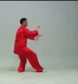
Prevention of Falls
Exercise regularly!
Focussed around improved leg strength and improving balance
Strength training
Tai Chi
Likely a combination of training methods best (balance training and strength training)
Notes:
1 horsepower lifts 550 lb by 1 foot in 1 second

Slide 19
Summary
Described changes of muscle mass and strength with age
Described prevalence of falls, fall risk factors, and exercise for prevention
Explained the role of exercise in minimizing deterioration
Notes:
1 horsepower lifts 550 lb by 1 foot in 1 second

